Slide 1
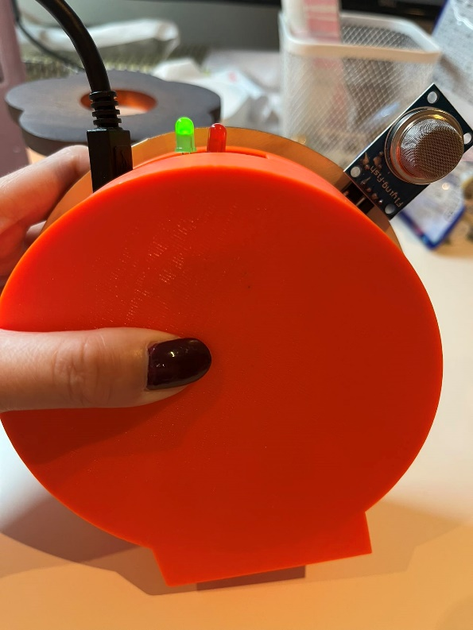
Smoke Alarm System
Qishu Qian

Slide 2
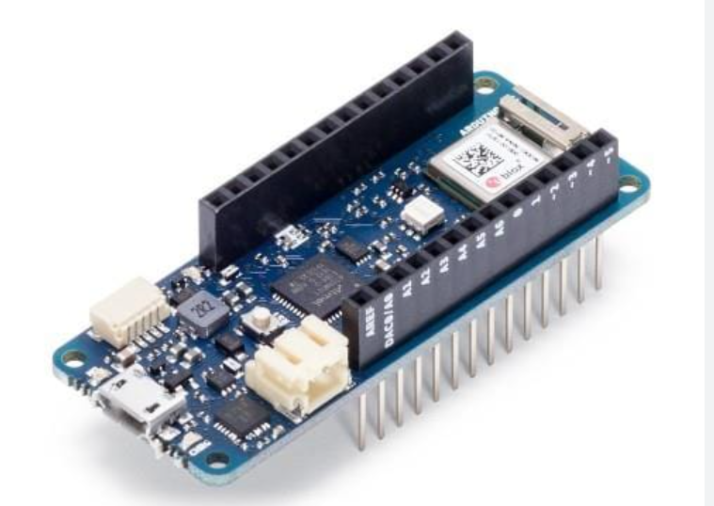
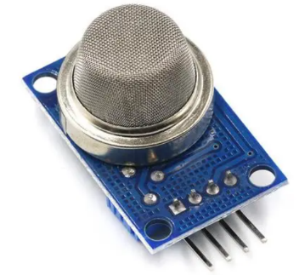
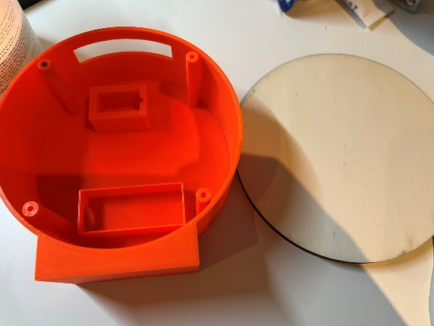
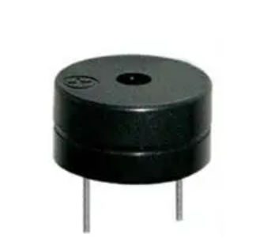
Components Used
MKR WIFI 1010: 5V and WiFi
MQ-2 smoke sensor
Green and Red LEDs
Buzzer
Box : 3D printing ( Boxes are unwanted components from other group projects. Thank you very much.)

Slide 3
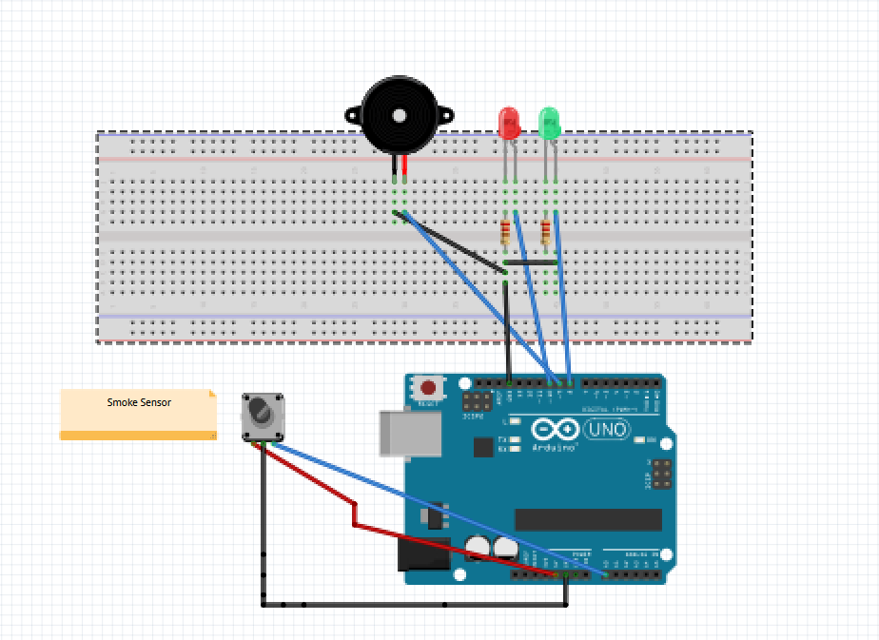
Circuit Diagram

Slide 4
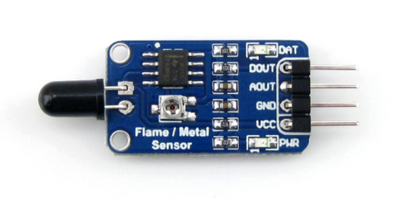
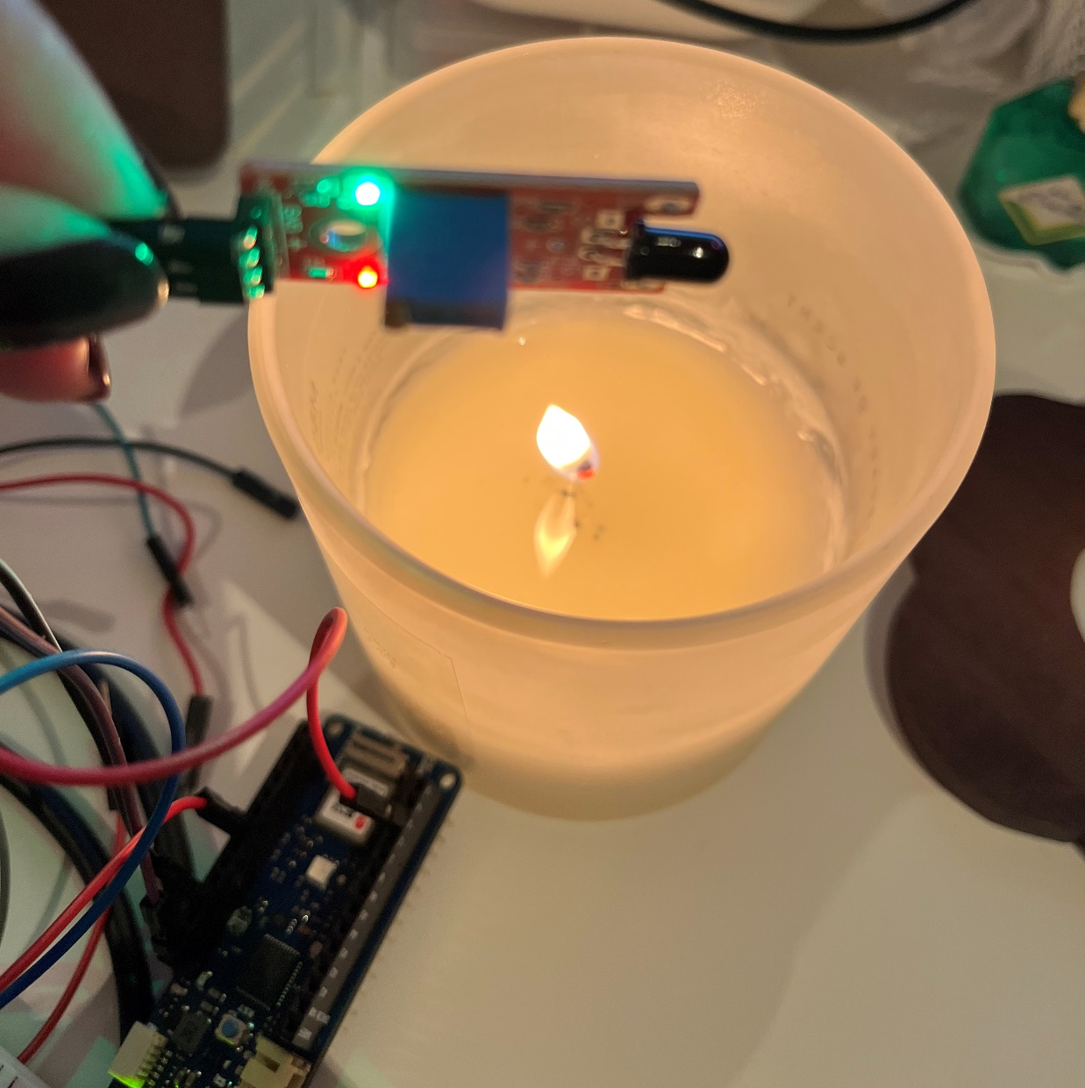
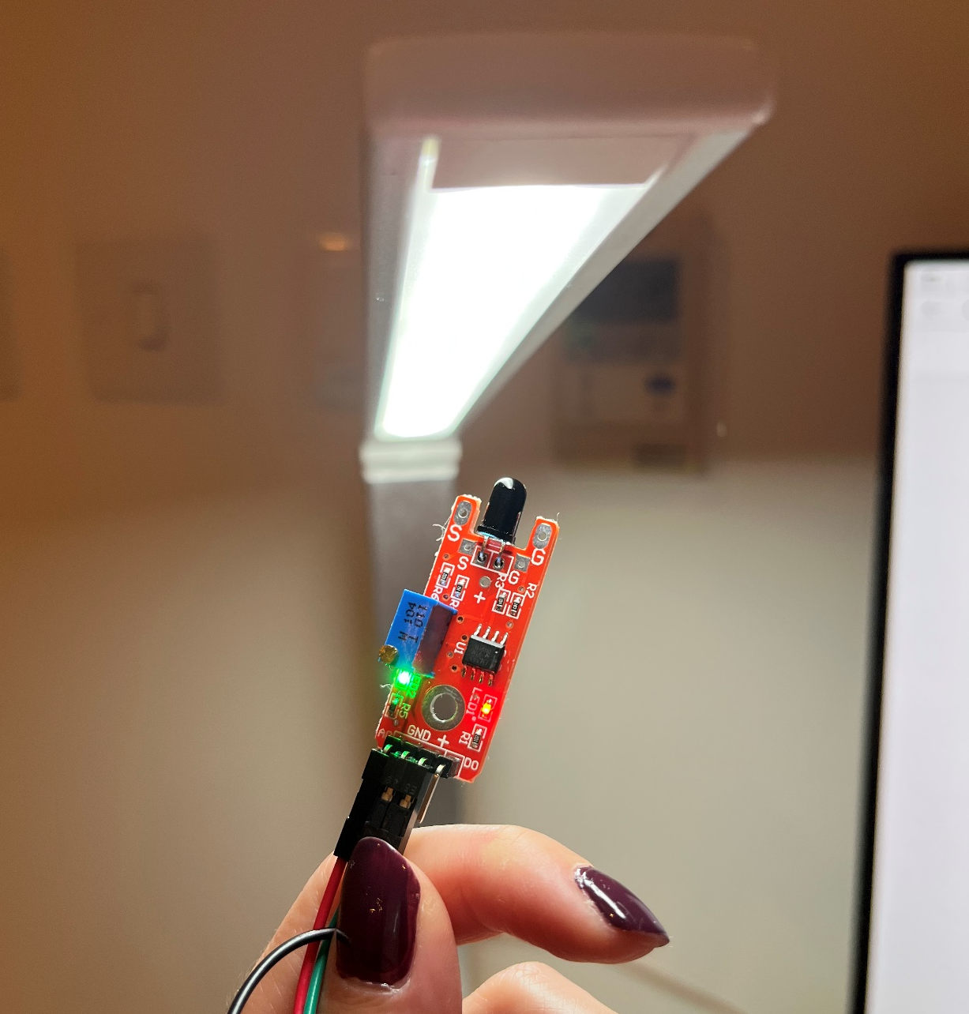
Cancel Flame sensor
The flame sensor uses an infrared receiver tube as the basic element, which is sensitive to flame and also responsive to ordinary light. When it is close to a more concentrated and bright light source, it will also output.

Slide 5
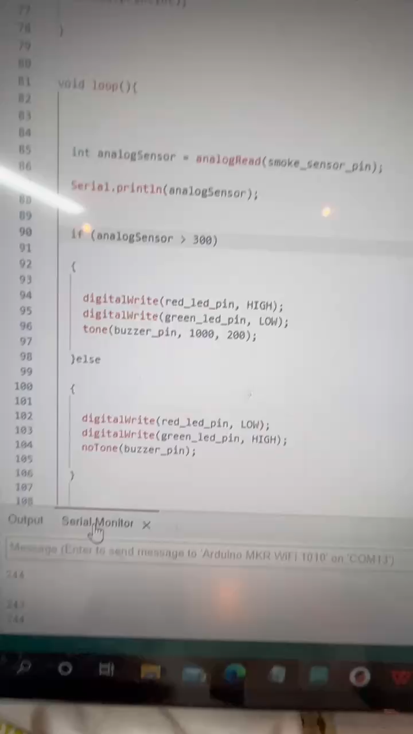
Video

Slide 6
Explanation
Use MQ-2 smoke sensor to detect gas concentration, and send the data to MQTT.
If the value of smoke concentration is lower than 400, the green light will be on. If the value is greater than 400, the red light will be on and the buzzer will alarm.
The concentration range is obtained by testing the smoke of extinguished candles and the smoke of kitchen cooking with induction cooker.
During normal cooking, the value of smoke will not exceed 400. When the candle is extinguished to produce obvious black smoke, the value of smoke will exceed 400.

Slide 7
Development
More suitable housing.
Alerts users using mail or message.
Simulate the smoke under various conditions to make the smoke range more accurate.
Make the buzzer sound louder. When I put the buzzer in the box, the sound will be a little muted.

Slide 8



Development
Top
Base

Slide 9
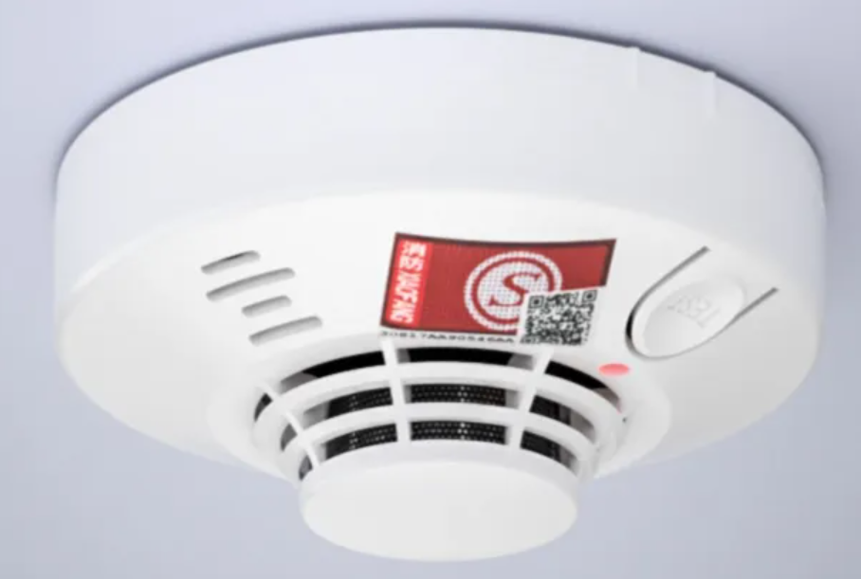
Thanks for listening

